Slide 1
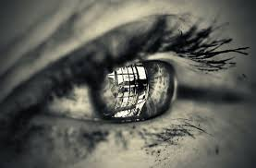
Reflective Journals in Post-secondary Education
A Writing Across the Curriculum Project
Noreen Bourgeois January 2017

Slide 3
Agenda
What is reflective journaling?
A little bit of theory
How to develop your reflective journaling assignment
Formats, components etc. of reflective journals
Development / frequency
Assessing students’ reflective journaling
Examples
Resources

Slide 4
What is reflective journaling?
The exploration and analysis of experiences in order to increase knowledge and awareness (Schon, 1983)
Reflection + clinical practice = further learning and promotion of integration and linking of new knowledge (Hubbs & Branad, 2005)
Connection between theory in the classroom and professional practice (Mann, Gordon & MacLeod, 2009)

Slide 5
Why do reflective journaling?
Personal development i.e. increased self awareness or development of emotional intelligence
Enhance professional development and clinical reasoning (Harrison & Fopma-Loy, 2009)
Encourage active learning and have learners take charge of their learning

Slide 6
Types of Reflection (Mann et al, 2009)
Reflection-in-action
Immediate reflection while learning is taking place
May be a verbal reflection and feedback from your mentor, fellow student or patient
A new or previously unrecognized problem may facilitate verbal reflection with mentor
Critical incident or trigger event
Reflection-on-action
Incorporation of previous knowledge and experiences in order to develop a deeper or novel understanding
Active learning

Slide 7
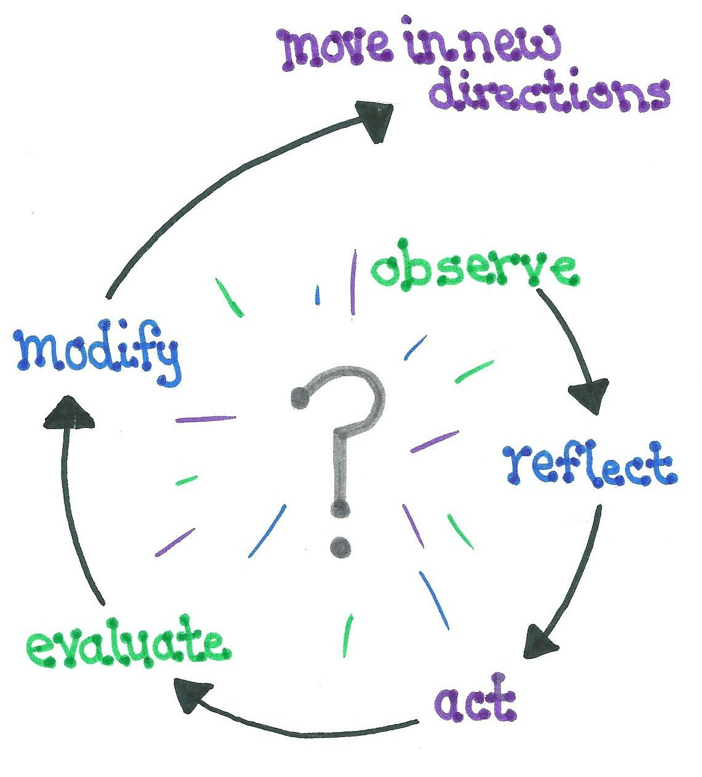
Correlation between critical thinking and reflection*
Adapted from Wetmore, A.O., Boyd., L.D. and Bowen D.M. (2010). Reflective blogs, p. 1348.

Slide 8
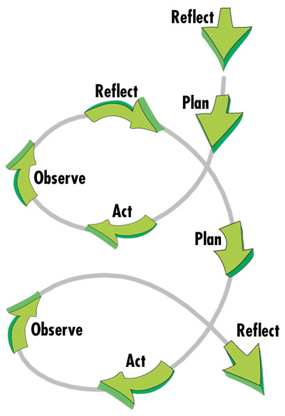
Continuous Improvement
Through Self –Reflection / Action:
**Learning loops**

Slide 9
Reflective Journal Formats
Written: have students respond to specific prompts or questions
Scrapbook with pictures / photos etc.
Visual journal i.e. via PPT or online
In LMS / BB – use journal function for written responses
Include future plans: What could I do better next time?

Slide 10
Tips for Faculty
Start with basic questions and move to more detail (scaffold the learning)
Provide clear expectations and examples before the students start their reflections
Make self-reflection a regular part of the learning (key dates)
Link journaling to other learning experiences (i.e. clinical / theory class)
Synchronize the questions with specific learning outcomes (i.e. reflection before and after a clinical experience or group project)
Give it value (marks!) so students will do it
Make the assignment easy to write and easy to mark!

Slide 11
Develop a reflective journal assignment
1. Identify what learning outcomes you are trying to assess, and the students are trying to achieve.
2. Identify any key learning outcomes such as...
- theories - standards - key skills / processes
- attitudes and beliefs - previous learning
- knowledge and understanding

Slide 12
Develop a reflective journal assignment
3. Develop a learning activity in which the student will learn about and experience the desired learning outcomes.
(It is better if the students will encounter the same type of experience several times so that they get used to the process of self-reflection.)

Slide 13
Develop a reflective journal assignment
4. Once the students have completed the learning activity, have them answer a set of questions about their experience that draws them towards reflection on their newly acquired learning.
The questions should invite the students to …
Describe what happened, including evidence
Value feelings
Analyze their learning experience
Link it to old learning / skills by reflecting on patterns
Self-critique their performance (strengths and challenges)
Apply theory to practice
Incorporate feedback
Identify next steps for learning

Slide 14
Develop a reflective journal assignment
5. Assess the students' reflections about their learning using a rubric you've developed that matches the questions the students answered. You will have to explain the rubric and your expectations to the students prior to the reflective journaling.
6. Allow students to practice and re-use this learning activity. Students will need to work through this self-reflection exercise several times before they start to link all of the learning and also articulate it. (moving from novice to experienced self-reflection)

Slide 15
Sample Questions for a Reflective Journal (maximum 5)
What have I learned today/this week? (thoughts, feelings, actions)
What feelings did I have about this learning experience? Why?
How does this relate to what I’ve learned before this?
What are my positive accomplishments / strengths during this learning experience?
How do I know this? (evidence)
What are my challenges?
How do I know this? (evidence)

Slide 16
Sample Questions for a Reflective Journal (maximum 5)
Were there any surprises about what I learned / experienced? (ahah moments!)
Have I felt / thought / acted this way before? (patterns of learning)
What do I need to work on? (future plans) What am I going to do to improve / enhance my learning / skills?
What actions / behaviours / thoughts do I need to work out?

Slide 17
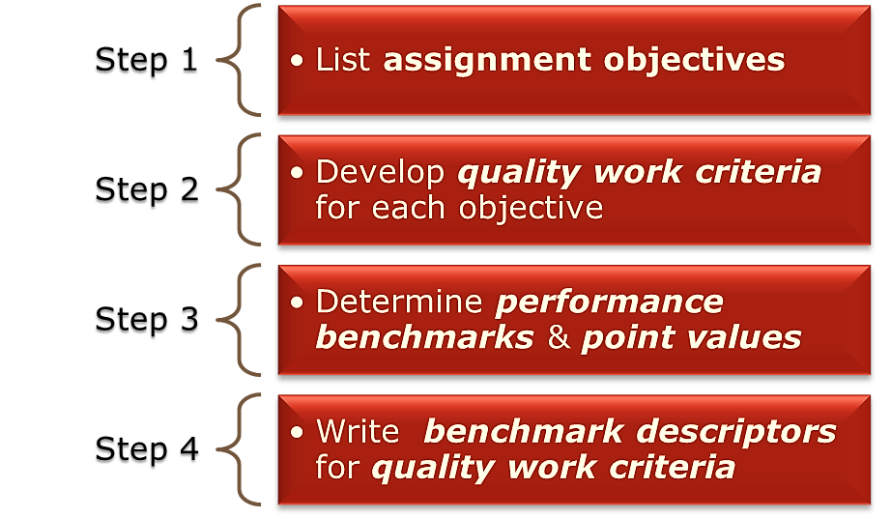
Developing a Rubric – Keep it simple

Slide 18
Example: Reflective Journaling in Dental Hygiene
Thanks to Trudi Enstrom, DH Coordinator for sharing!

Slide 19
Dental Hygiene Student Reflective Journal Components
Answer the core questions (4).
You will be reflecting on TWO WEEKS of preclinical/clinical practice; you may choose to focus on something that went well and something that needs work.
Use complete sentences/paragraphs to describe and analyze the experiences, thoughts, feelings and actions from clinical.
This is not a list of all the skills/techniques/process you completed
Identify areas for improvement and a plan of action.
Include APA citations/evidence to support your ideas.

Slide 20
The Reflective Journal Core Questions (Dental Hygiene)
What went well today/in the last two weeks in preclinical/clinical? Include descriptions and analysis of the following:
Your feelings and attitudes
You thoughts about your experiences; knowledge and skills
Your actions and behaviours: what you did and said; responses and actions; planning, preparation and outcomes
anything that “surprised” you
What was difficult for me?
Feelings and attitudes
Thoughts: knowledge and skills
Actions and behaviours
Suggestions from faculty, mentors, fellow students (should patients be included here?)
Any specific incidents
How can I improve? Be specific. Include evidence: clinical notes, class notes, practice notes, standards, guidelines, textbooks, articles, etc. Use APA format*.
Review of previous learning; new study
Review and additional practice of processes, skills
Professional attitudes and behaviours
After first reflective journal submission:
What actions/activities/studies have I completed since my last reflective journal submission?
What was most helpful to me?
In which areas do I need to continue working/reviewing/practicing?
What actions do I need to complete in the coming weeks?

Slide 21
Sample Reflective Journal Entry
1. What went well today/in the last two weeks in preclinical/clinical?
This past week in the dental clinic felt wonderful! For the first time, I actually felt like I knew what I was doing! I completed an entire assessment on a more difficult case type and I was told by my instructor that the assessment was well done. This is a first for me and I was surprised at how good I felt.
2. What was difficult for me?
During the huddle prior to clinic on Monday my instructor asked me some very specific questions in regard to the client I was seeing that day. I was not very well prepared to answer the questions I was asked. I felt “put on the spot” by the questions even though the instructor was nice about my lack of knowledge in regard to my patient. It was suggested that perhaps I look over my chart the day before clinic to ensure that I know what procedures I will need to perform and perhaps review the client information in order to better present my case in the huddle.

Slide 22
Sample Reflective Journal Entry, cont’d
3. How can I improve?
In future, I will make sure that I am prepared for clinic. I will set up my station at least a half hour ahead of time and I will make sure that I preview my clients chart in order to know what procedures I will be performing that day. It is important that clinical notes be reviewed prior to treatment so that I may have time to review any treatment procedures that I am unsure of and also to reinforce where my client stands in regard to the treatment being rendered that day (Darby and Walsh, 2014).
References:
Darby, M. L., & Walsh, M. (2014). Dental hygiene: theory and practice. Elsevier Health Sciences.

Slide 23
Sample Reflective Journal Rubric
 | LEVEL
CRITERIA | UNSATISFACTORY | NEEDS IMPROVEMENT | SATISFACTORY | REFLECTIVE PRACTITIONER | MARKS: 10
Q 1-2 DESCRIPTION OF LEARNING EXPERIENCE |  |  | - thoroughly describes their own thoughts, feelings, actions regarding a specific experience. -Abstract concepts are explained accurately. Explanation of concepts makes sense to the uninformed reader. -The reflection on the learning experience is relevant and meaningful to student and clinical outcomes |  | 3
Q 1-2-3 ANALYSIS |  |  | -reflects upon the relevance and meaningfulness of the learning experience to the student and also clinical outcomes. -A clear connection(s) between the learning experience and previous studies/practice and/or personal goals. |  | 2
To be added
To be added
To be added
To be added

Slide 24
 | LEVEL
CRITERIA | UNSATISFACTORY | NEEDS IMPROVEMENT | SATISFACTORY | REFLECTIVE PRACTITIONER | MARKS: 10
Q 3 SELF-CRITIQUE/ APPLICATION |  |  | -Thorough attempt at self-critique and clearly demonstrates a new awareness of personal behaviours and attitudes. Student clearly identifies areas for further study/practice or investigation. -Student provides a future goal(s) for learning. - Student has completed most/all previously identified actions for self-improvement; new steps are identified or rationale is given for unfinished tasks or in-process learning. |  | 3
To be added
To be added

Slide 25
 | LEVEL
CRITERIA | UNSATISFACTORY | NEEDS IMPROVEMENT | SATISFACTORY | REFLECTIVE PRACTITIONER | MARKS: 10
Q 1-4 OVERALL WRITING /EVIDENCE |  |  | -Grammar and spelling are correct. Word choice/ terminology is appropriate. -Writing is concise and easy to understand; logical presentation of ideas. -Student has provided evidence of identified sources of information. All citations or references are provided accurately in APA format. |  | 2
 | TOTAL |  |  |  | /10
To be added
To be added

Slide 26
Template for a Reflective Journal Rubric
 | No reflection evident (0) | Some reflection evident (1) | Good reflection (2) | Excellent reflection (3) | Marks allotted (4)
Description of thoughts, feelings, actions
Analysis Link to previous learning Theoretical links skills /behaviours /attitudes
Self-critique: strengths/challenges
Next steps / Action Plans
Evidence used (APA)
Format (writing, visuals)
Insert benchmarks / expected levels of performance here
Weight components as per expectations

Slide 27
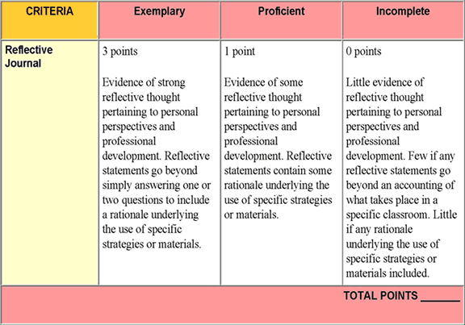
Reflection Journal Rubric (simple format)

Slide 28
More information about Reflective Journals
McMaster University Reflective Journaling
http://srs-mcmaster.ca/wp-content/uploads/2015/04/Clinical-Education-Mini-Manual-for-Students-MScOT-Program-McMaster-University-2014.pdf
Use of Reflection in Social Work
http://www.bcasw.org/wp-content/uploads/2012/11/Reflective-Journal-Writing-H1.pdf
Sample rubrics:
http://www.d.umn.edu/~balbert/humandiversity/grading_rubric.html
How to develop a rubric:
http://www.algonquincollege.com/profres/assessing-students/assessment-tools-techniques-4-2/

Slide 29
Help with APA format:
American Psychological Association. (2016). APA Style website. Retrieved from http://www.apastyle.org/index.aspx
Haig, J., MacMillan, V., & Raikes, G. (2014). Cites & sources: A documentation guide (4th ed.). Toronto, Canada: Nelson Education Ltd. ISBN: 978-0-17-650852-4.
Purdue University. (2015). APA Style, The OWL at Purdue. Retrieved from https://owl.english.purdue.edu/owl/resource/560/01/

Slide 30
References
Harrison, P.A., & Fopma-Loy, J.L. (2010). Reflective journal prompts: a vehicle for simulating emotional competence in nursing, Journal of Nursing Education, 49(11), 644-652.
Hubbs, D.L. & Brand, C.F. (2005, April 1). The paper mirror: understanding reflective journaling. Journal of Experiential Education, 28 (1), pp60-71. Retrieved online from Ebscohost.
Mann, K., Gordon J., & MacLeod A. (2009, Oct.).Reflection and reflective practice in health professions education: a systematic review. Adv Health Sci Educ Theory Practice, 14(4):595-621. Retrieved from NCBI PubMed.
Shimmell, L. (2014). Reflection in Practica. McMaster University. Retrieved online from srs-mcmaster.ca
Schön, Donald A. (1983). The reflective practitioner: how professionals think in action. New York: Basic Books. ISBN 046506874X. OCLC 8709452.

Slide 31
