Slide 1
Plagiarism: Defining, understanding and preventing it

Slide 2
To plagiarize means…
To steal and pass off ( the ideas or words of another) as one’s own
To use without crediting the source
To commit literary theft
To present as new and original an idea or product derived from an existing source

Slide 3
Plagiarism involves both stealing someone else’s work and lying about it afterward.
Changing the words of an original source is not sufficient to prevent plagiarism.
If you have retained the essential idea of an original source and have not cited it, then no matter how drastically you may have altered its context or presentation, you have still plagiarized!

Slide 4
Before discussing the types of plagiarism students may present, it may be useful to begin by acknowledging the necessary internal tensions in our conventions and requirements, what have been called “the contradictions of academic writing.” Students are often told in College:
Show you have done your research — But — Write something new and original
Appeal to experts and authorities — But — Improve upon, or disagree with experts and authorities
Improve your English by mimicking what you hear and read — But — Use your own words, your own voice
Give credit where credit is due — But — Make your own significant contribution
(Purdue Online Writing Lab, 2004).

Slide 5
These paradoxes are, at one level, perfectly reasonable, something that every academic writer has to master. And yet they can be extremely intimidating and confusing, especially to beginning students making the transition from a high school aesthetic, in which copying verbatim from reference works may have been winked at as a form of research writing.
Here the inequality of the secondary education system may come into play: being explicit about expectations and standards can help to level the playing field, and to compensate, to some degree, for disparities of preparation.
A student coming from high school faces enough challenges in college without stumbling into accusations of plagiarism that stem not from a desire to deceive but from unfamiliarity with tenets of academic procedure which the instructor and some students have internalized long ago as articles of faith.
For such students, even seemingly mechanical aspects of research, such as following documentation formats, may turn out to be non-trivial, and may require much more in-class time than an instructor may have expected (Wells, 1993, p. 62).

Slide 6
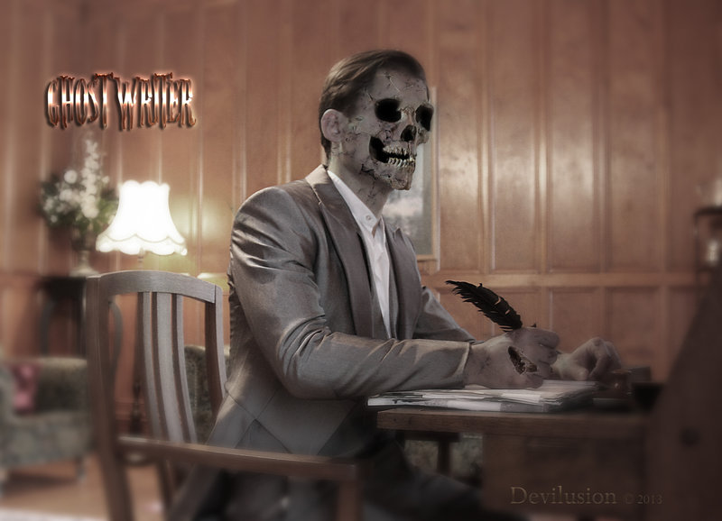
To understand how to prevent it, it is important that both instructors and students are aware of the many types of plagiarism that exist. Types of Plagiarism—Not Cited
The Ghost Writer
the writer turns in another’s work, word-for-word, as his own.

Slide 7
Types of Plagiarism—Not Cited
The Photocopy
the writer copies significant portions of text from a single source without changing it.

Slide 8
Types of Plagiarism—Not Cited
The Potluck Paper
The writer combines several different sources tweaking the sentences to make them fit together while retaining most of the original phrasing.

Slide 9
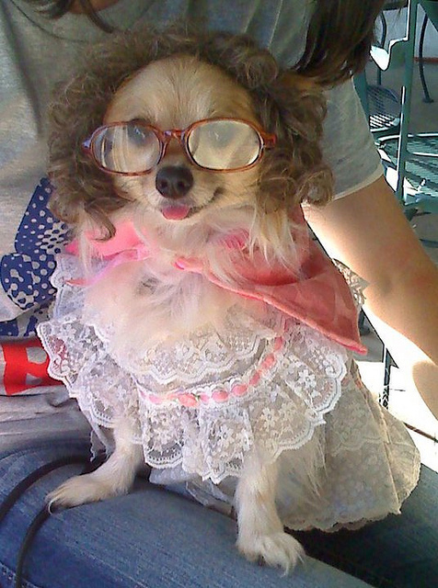
Types of Plagiarism—Not Cited
The Poor Disguise
The writer has slightly altered the paper’s appearance by changing keywords and phrases.

Slide 10
Types of Plagiarism—Not Cited
The Self Stealer
The writer borrows from his or her previous work, violating policies concerning the expectation of originality.

Slide 11
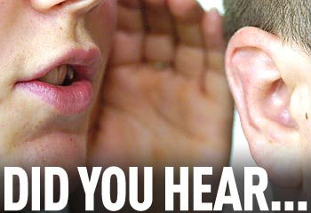
Types of Plagiarism—Cited
The Misinformer
The writer provides inaccurate information regarding the sources, making it impossible to find them.

Slide 12
Types of Plagiarism—Cited
The Too-Perfect Paraphrase
The writer properly cites a source but neglects to put in quotation marks text that has been copied word-for-word.

Slide 13
Types of Plagiarism—Cited
The Resourceful Citer
The writer properly cites all sources, but the paper contains almost no original work.

Slide 14
Types of Plagiarism---Cited
The Perfect Crime
The writer properly quotes and cites sources in some places, but goes on to paraphrase other arguments without citation.

Slide 15
Resources
Plagiarism interactive module website:
http://library.acadiau.ca/sites/default/files/library/tutorials/plagiarism/
Useful article on how instructors can prevent plagiarism in the classroom.
http://wac.colostate.edu/atd/articles/hall2005.cfm

Slide 16
Ways to help students avoid plagiarism
We encourage faculty across the curriculum to extend on the foundation created in CS007 Communications by:
Introducing students to the citation system used in your discipline
Sharing tips and strategies with students on the best way to find and evaluate disciplinary sources
Giving students low-stakes practice with using sources in your discipline before asking them to complete high-stakes assignments.

Slide 17
Prevent plagiarism through pedagogy.
Suggested Activities:
1. Have faculty, librarians, WAC staff, and others use the WAC anti-plagiarism learning module. This module is composed of an online component, but could also include a printed component, an in-class (or in-library) component, and even a video component.
2. Encourage plagiarism-proof assignment design and course structure. Incorporate these issues into faculty training efforts, and make them part of the discussion as faculty propose new courses or bring up existing ones for re-designation.

Slide 18
3. Develop and disseminate materials and resources for students to help them understand what plagiarism is, and, more importantly, how to use sources in an appropriate and creative manner. These materials are available online, in the library, on our WAC website, in student handbooks, etc. (ex. CC SafeAssign application) 4. Survey faculty attitudes about the severity of the plagiarism problem on a particular campus, what they see as its causes, and what kinds of help they would like. Document and clearly communicate current anti-plagiarism practices.
Cited from: Hall, Jonathan. (2005, February 9). Plagiarism across the curriculum: How academic communities can meet the challenge of the undocumented writer. Across the Disciplines, 2. Retrieved November 28, 2016, from http://wac.colostate.edu/atd/articles/hall2005.cfm

Slide 19
Get students involved in developing anti-plagiarism activities. (Help faculty, administrators, librarians, and tutors understand the student experience of plagiarism and incorporate that perspective into their interactions.)
Suggested Activities:
Display original student work as templates/exemplars within your classroom or at the College in order to give a high profile to students' authentic academic works.

Slide 20
Train tutors, workshop leaders, and instructors to understand the experience of plagiarism from the student perspective, as an indispensable first step toward addressing the problem effectively. Encourage tutors, librarians, and others with one-on-one contact with students to raise issues of plagiarism–and proper use of sources–when appropriate.
Have the library staff not only help students find sources, but also to evaluate them for appropriateness for a given project, and to use them effectively and honestly in their own arguments. Information literacy must be a core goal of all contemporary colleges, and anti-plagiarism efforts need to be a key component of any such initiative.
Conduct anonymous in-class quick writes/short responses to gauge student understanding of plagiarism as a concept, their attitudes toward it, its prevalence, methods, trends, etc.

Slide 21
When prevention fails, make the plagiarism intervention not only an occasion for punishment, but also an educational opportunity, a way to prevent the next plagiarism.
Suggested Activities:
Train faculty to detect plagiarism, and to track down sources of plagiarized papers — search-engine strategies, Turnitin.com, Glatt plagiarism screening, etc — .but emphasize how to use these technological tools without creating an adversarial atmosphere in the classroom.

Slide 22
Working with campus judicial officials, administration, faculty, and students, develop an effective procedure to deal with cases of plagiarism, focusing especially on approaches that are not purely punitive, though they may involve some significant sanctions.
For example, the student may have to take a class/set of classes that teach what plagiarism is and how to prevent it in the future, as well as to complete some specific assignments that demonstrate his/her new awareness of this topic.
The Dean (or other appropriate judiciary officer) would retain a central file of students who go through this process; second offenses should be dealt with more severely.

Slide 23
Review Blackboard application: SafeAssign

