Slide 1
The Flu Vaccine Effectiveness in Relation to Determinants of Health
Communication for Health Professionals
By: J. L. and Group

Slide 2
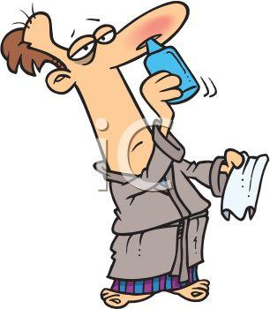
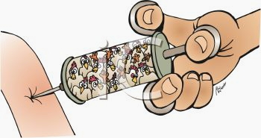
The Influenza Virus and the Vaccination

Slide 3
The Influenza Virus
The influenza virus is an acute respiratory virus that can affect Canadians of all ages.
Common Symptoms:
Onset of high fever
Coryza (Inflammation of mucous membrane in the nose)
Cough
Headache
Prostration (extreme fatigue/exhaustion)
Malaise (discomfort/uneasiness)
Inflammation of the upper respiratory tract and trachea
The symptoms can last from 7-10 days and general weakness and fatigue for weeks after.
(Taubenberger & Morens, 2008, para. 6)

Slide 4
The Influenza Vaccine
An effective way to protect ourselves from the virus is by getting a vaccination!
According to Centers for Disease Control and Prevention the influenza vaccine works by, “causing antibodies to develop in the body about two weeks after vaccination”(Centers for Disease Control and Prevention, 2014). These antibodies provide protection against infection with the viruses that are in the vaccine”. (NHS choice, 2015, para. 2) “If you’re exposed to the flu virus after you’ve had the flu vaccine, your immune system will recognize the virus and immediately produce antibodies to fight it” (NHS choice, 2014, para. 3)

Slide 5
Selecting the Strain
Every year the World Health Organization decides the strain in the vaccine. The WHO, “reviews the world epidemiological situation twice annually and if necessary recommends new vaccine strains in accordance with the available evidence” (WHO, 2014, para. 4). The vaccine “contains a mixture of influenza strains thought most likely to circulate in the coming season” (WHO, 2014 para. 4).“The virus is grown in chick embryos or cell cultures for the production of vaccines” (WHO, 2014 para. 4). “The viruses are then killed (deactivated) and purified before being made into the vaccine” (NHS, 2015, para. 14). The below diagram demonstrates how the strain is chosen in more detail.

Slide 6
Purpose of Our Study
We explored two avenues of interest regarding influenza.
The effectiveness of the flu vaccine in relation to other determinants of health, including public opinion regarding vaccines.
2. The validity and frequency of the occurrence of side effects in relation to the flu vaccine.

Slide 7
Participants and Data Collection
Internet survey on “Survey Planet”
16 questions regarding flu vaccines, demographics, and characteristics associated with health
82 participants

Slide 8
OUR RESULTS!

Slide 9
Are Vaccinations Effective?
Are vaccines effective?
Nichol et al (1995) found vaccines reduced flu by 25%
Ontario Ministry of Health (2014) predicts 60-80% prevention

Slide 10
Are Vaccinations Effective?
Are vaccines effective?
We asked participants whether or not they received a flu vaccine and if they became ill with the flu afterwards.

Slide 11
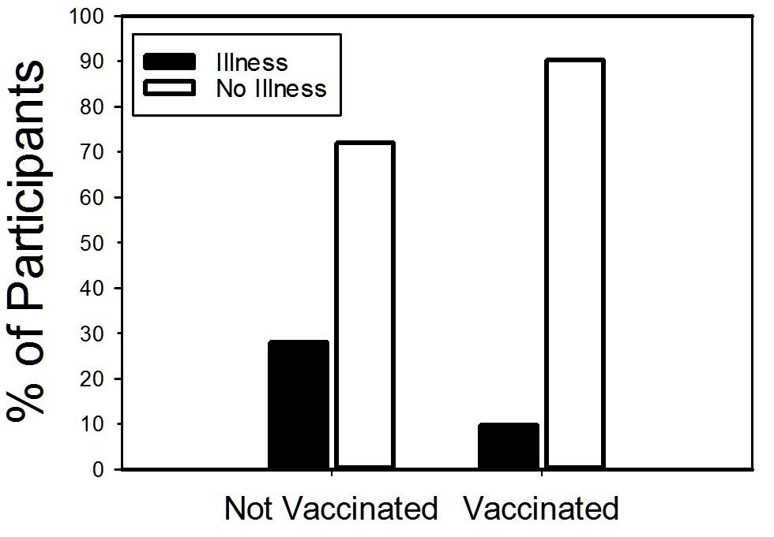
28%
10%
The percentage of participants who became ill vs those did not become ill after receiving a vaccination or not

Slide 12
Some people who get vaccinated still get the flu.
Some others who do not get vaccinated remain free from infection of the virus.
We explored other factors that might be important like exercise, socioeconomic status, education, and gender.

Slide 13
Exercise
Kohut (2004) explains that exercise improves antibody response to influenza vaccine
Canadian Society of Exercise Physiology (2011) >150 minutes
Nieman (1990) when is it too much?

Slide 14
Exercise
How much do you vigorously exercise per week?
Low group (60 minutes or less)
High group (90 minutes or more)

Slide 15
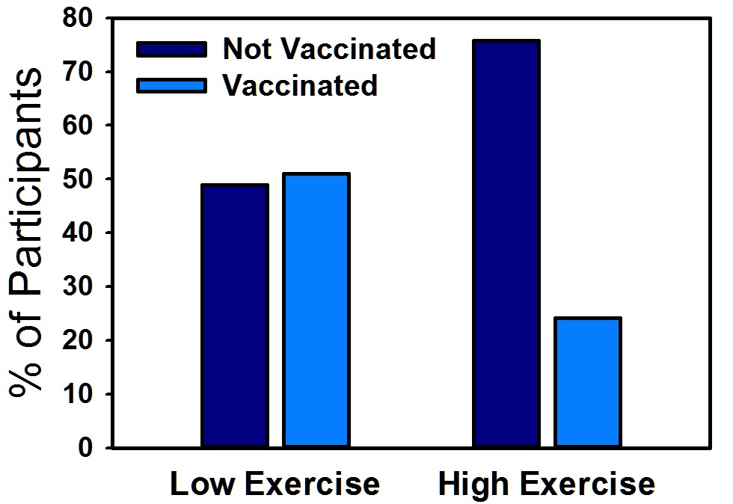
51%
24%
The percentage of low and high exercisers who chose to get vaccinated compared to those who did not get vaccinated.

Slide 16
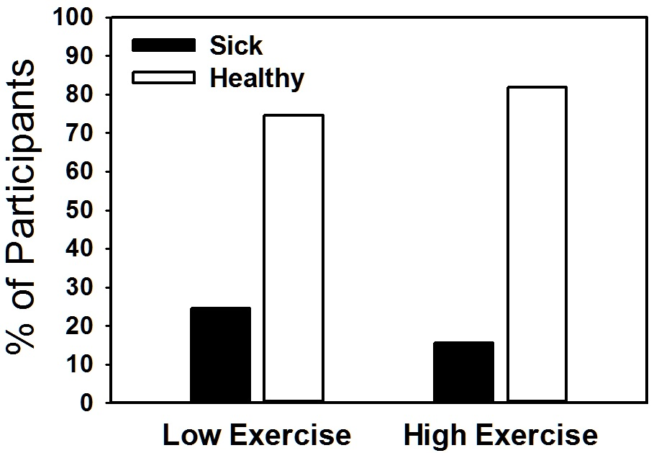
25%
16%
The percentage of low and high exercisers who became ill compared to those who did not become ill regardless of being vaccinated or not.

Slide 17
Socioeconomic Status
Federal, Provincial and Territorial Advisory Committee on Population Health (1994, 1999)
Socioeconomic status is the biggest determinant of health

Slide 18
Socioeconomic Status
Mikkonen and Raphael (2010)
Wealthiest 20% vs poorest 20%
Death rates in most deprived areas
Suicide rates

Slide 19
Socioeconomic Status
We asked participants their annual household income
We divided them into two groups based on income:
Over $55,000 (Higher) and less
than $55,000 (Lower)

Slide 20
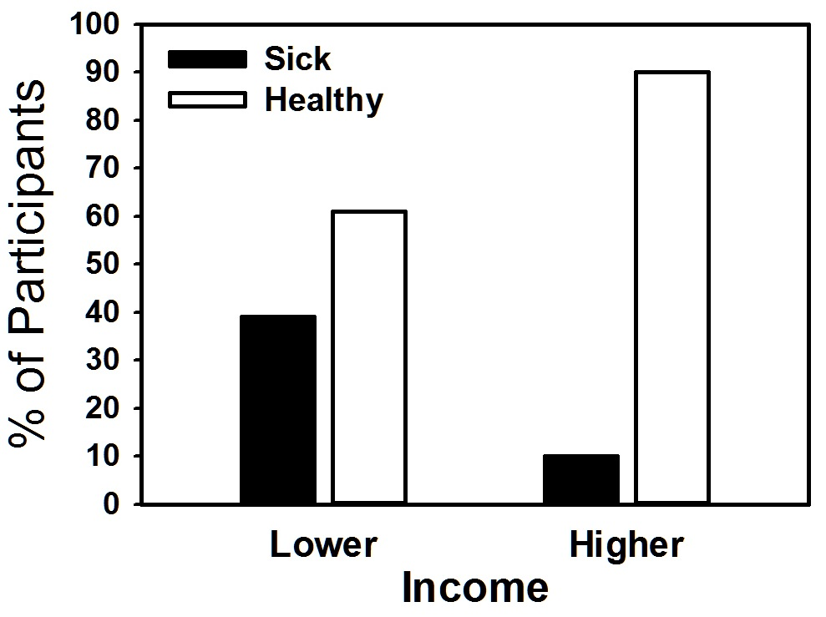
39%
10%
The percentage of lower and higher income participants who did not get vaccinated and became ill compared to those who were not ill.

Slide 21
Gender
Our data revealed that proportionately, more females in our survey chose to get vaccinated (22 out of 50, 44%) compared to males (11 of 30, 37.7%). However, although more females were vaccinated, they also became ill more frequently (12 of 50, 24%) compared to males (4 of 30, 13.3%). Most of the illnesses came from the unvaccinated group, 75% for females and 100% for males.

Slide 22
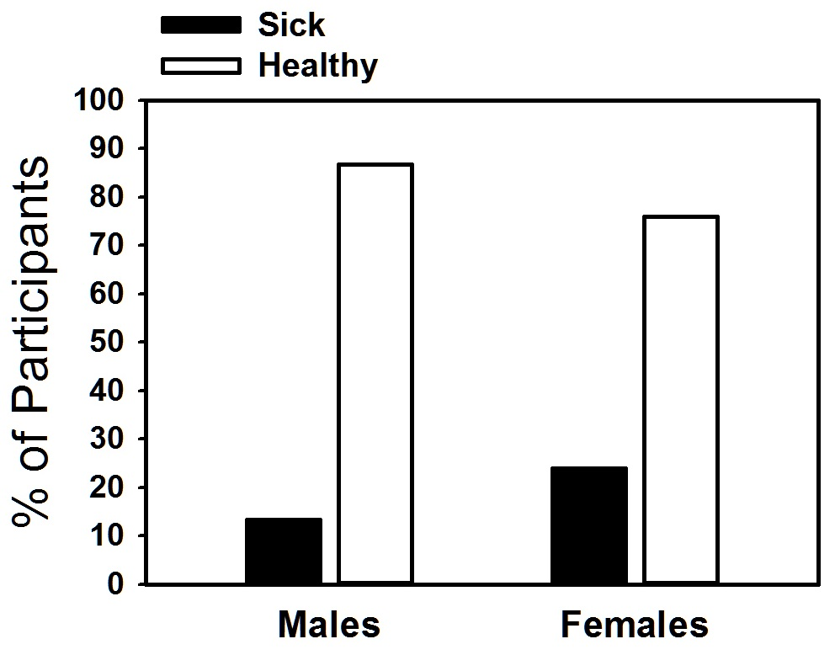
24%
13%
The percentage of males and females who became ill or not.

Slide 23
Education
Our respondents were generally well-educated. Over half (47 of 82, 57%) completed at least a college or university degree. Based on results, it seems that education may be a factor in avoiding flu. We divided education into a “lower” group who had not completed a college or university degree (n=35) and compared them with a “higher” group that had completed a college or university degree (n=47). The lower and higher groups had an almost equal proportion of vaccinations (37.1% and 38.3%, respectively), however, the higher group did become ill less often showing a rate of only 17.0% compared to 25.7% of the lower group, as can be seen in Figure 7

Slide 24
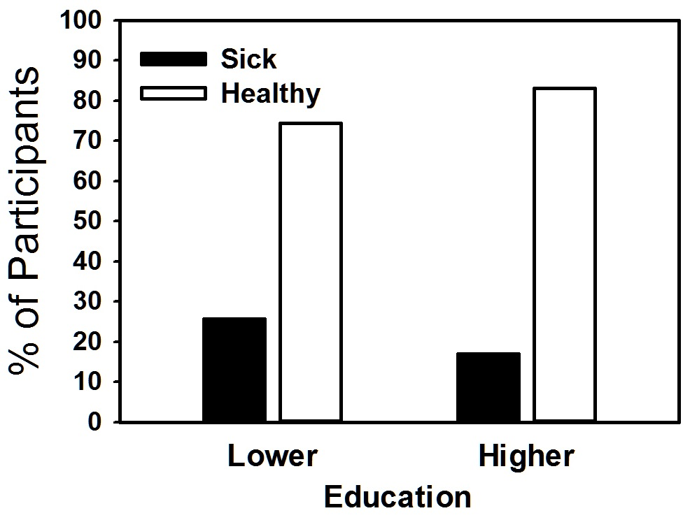
26%
17%
The percentage of participants who became ill or not with a “lower” or “higher” education.

Slide 25
Self Worth
Participants were asked how agreeable they were with the statement, “I am needed in society” in an attempt to measure one’s sense of self-worth.
Seventy participants (85%) were agreeable with the statement, compared to twelve who were not (15%).
The “lower” self-worth group showed a similar rate of vaccination (58%, 5 of 12) compared to the “high” (60% 28 of 70). However, as can be seen in Figure 8, 50% (6 of 12) of the “lower” group reported an illness compared to only 16% (11 of 69) of the “high” self-esteem group. These results suggest that feelings of self-worth may be an important factor in preventing flu.

Slide 26
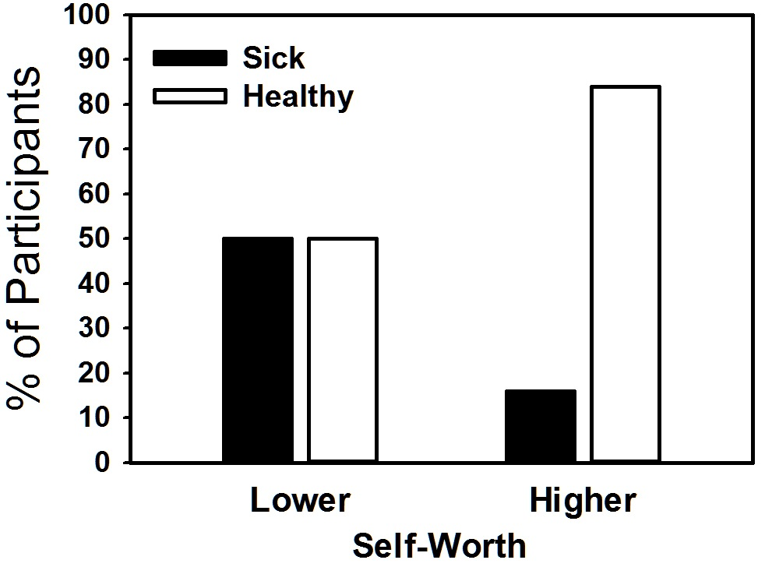
50%
16%
The percentage of participants who became ill or not with a “lower” or “higher” self-worth.

Slide 27
Reasons For Not Getting Vaccinated
We asked participants who did not get a flu vaccine in the prior year, “Why not?” These were the top most significant answers:
“I believe I am healthy enough to fight an infection off” - 14 responses (28.6%)
“I don’t believe flu shots are effective” - 16 responses (32.7%)

Slide 28
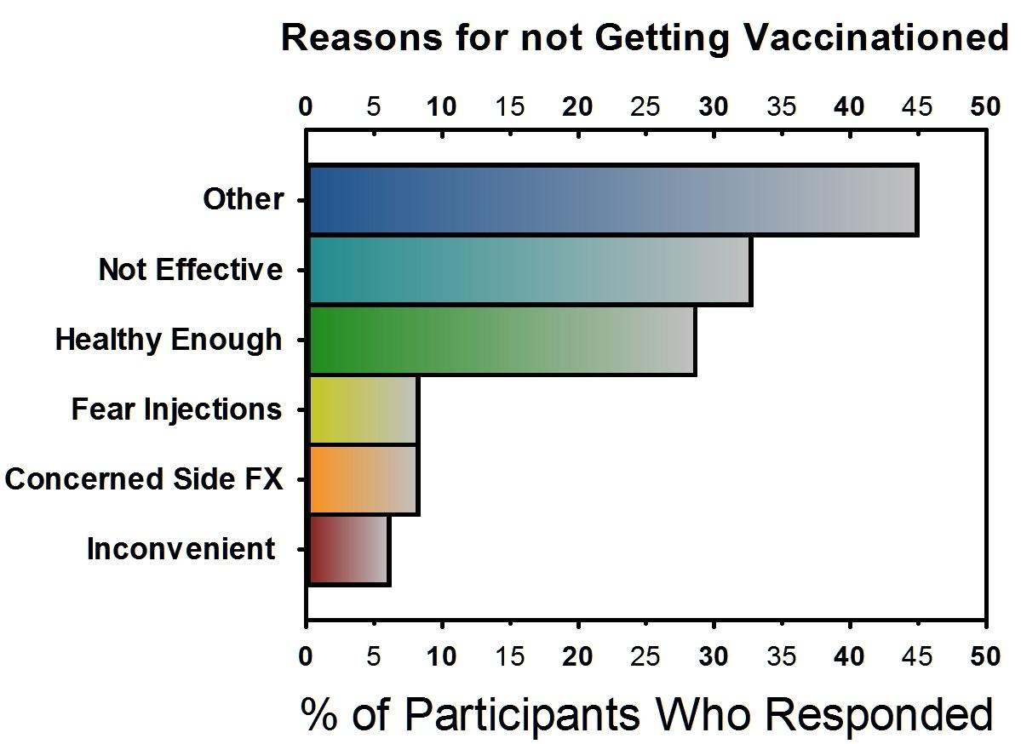
The percentage of participants’ responses pertaining to why they chose not to get vaccinated.

Slide 29
Side Effects
There have been anecdotal reports that vaccinations do in fact cause flu-like symptoms, while medical science has made it clear that vaccinations should not cause the flu .

Slide 30
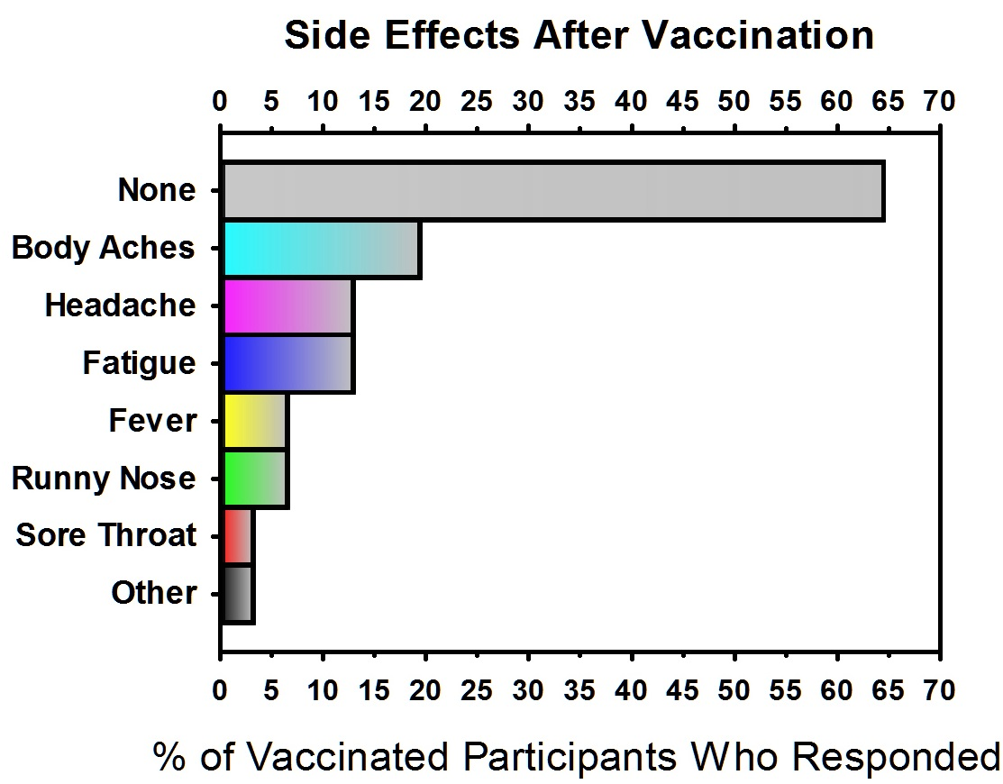
The proportion of different side effects experienced by participants after being vaccinated

Slide 31
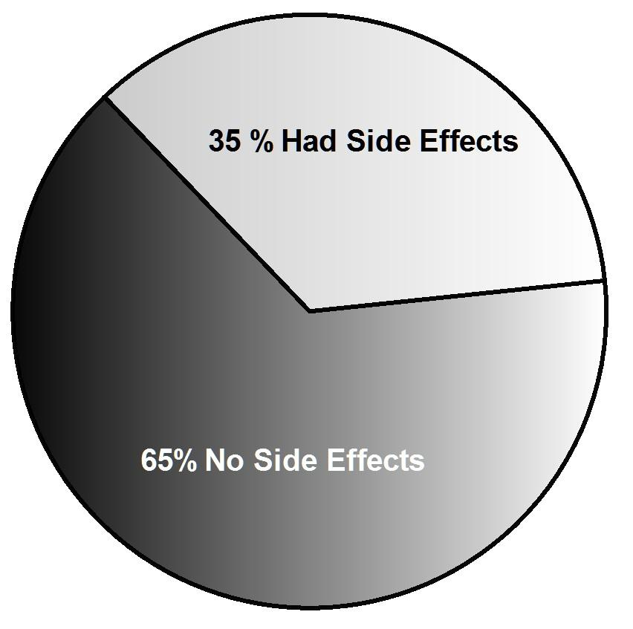
We confirmed that people who are vaccinated do experience some side effects. As this chart shows we found that about one-third of participants reported side-effects.

Slide 32
Opinions Regarding
Flu Vaccines
Participants were asked their opinion regarding the effectiveness of flu vaccines.
The most popular answer was ,“Sometimes effective at preventing the flu.” was given by 39% (31 of 82) participants.
The least number of participants (7% or 6 of 82) believed that vaccines are not effective at preventing flu.

Slide 33
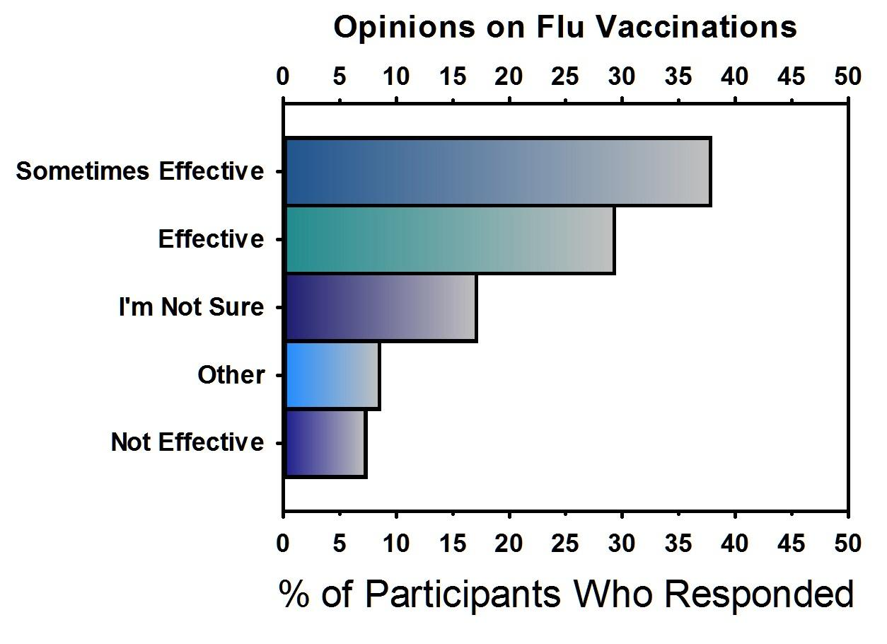
The proportion of different beliefs regarding vaccinations from all participants.

Slide 34
Beliefs about the effectiveness of flu vaccine seemed to have an effect on whether or not people actually chose to get vaccinated, and whether or not they became ill.
We divided participants into two groups based on their beliefs regarding flu vaccines.

Slide 35
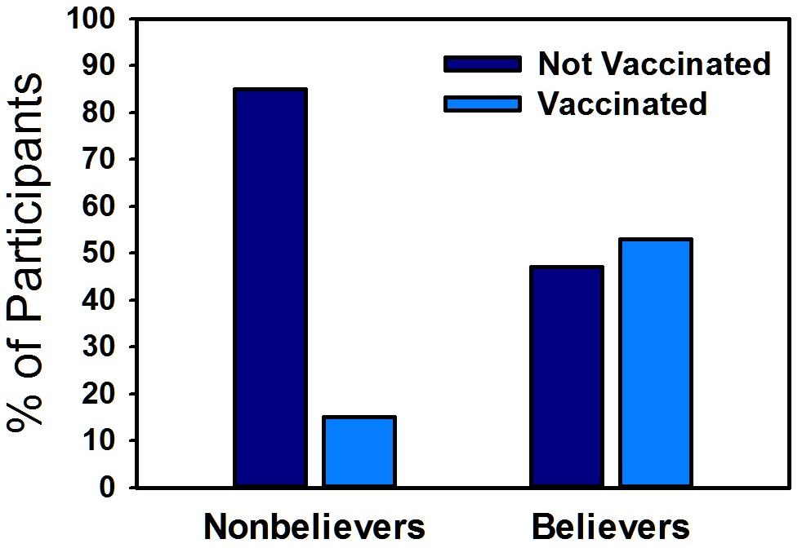
53%
15%
Of the participants that thought vaccines were at least sometimes effective, 53% (29 of 55) became vaccinated, compared to only 15% (4 of 27) of the others groups.

Slide 36
The rate of illness also differed between participants based on their beliefs.
Only 16% of participants (9 of 55) that believed vaccinations were at least sometimes effective became ill. In comparison, 69% (9 of 13) of participants who were unsure about flu vaccines or thought they were ineffective, or “other” became ill.

Slide 37
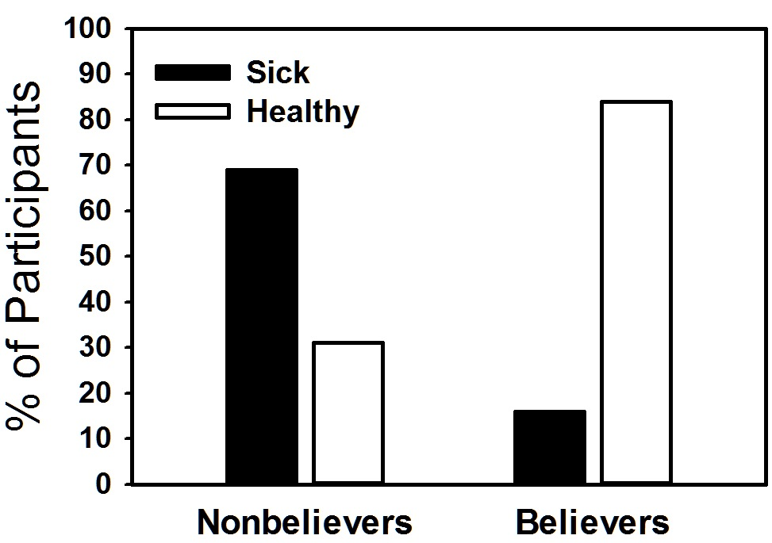
69%
16%
Our results suggest that people’s beliefs on vaccinations have a strong influence on whether or not they get sick.

Slide 38
Conclusions
and
Recommendations

Slide 39
Flu vaccinations are an effective means to prevent flu.
We recommend people get vaccinated annually and encourage your family to do the same.

Slide 40
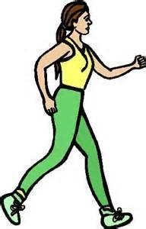
People who exercise more, seem to become ill less.
Canadian Society of Exercise Physiology (2011) >150 minutes per week

Slide 41
Participants who have an average household income of over $55,000 are less likely to become infected with the flu.
More equal distribution of wealth has proven to be one of the best predictors of health (Mikkonen and Raphael, 2010)

Slide 42
Females in Ontario may have a higher risk of flu infection

Slide 43
Having a high level of education seems to be associated with a lower rate of illness from flu.

Slide 44
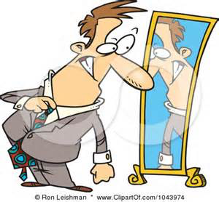
Feelings of low self-worth seem to increase the chances of flu infection.

Slide 45
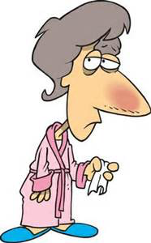
Flu vaccines do cause side effects that could imitate some flu symptoms, in about one-third of participants, but this might just be a placebo effect.

Slide 46
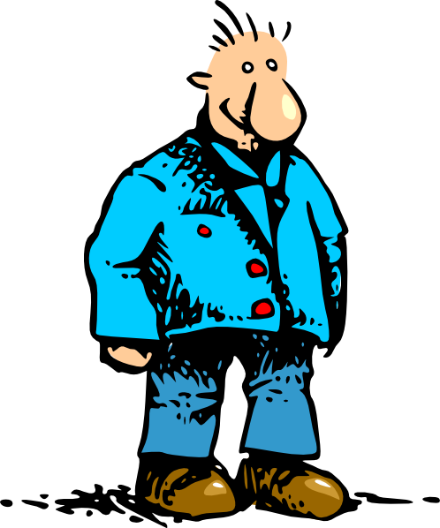
People’s beliefs regarding flu vaccines have a major influence on whether or not they get vaccinated and whether or not they become ill. Participants who believe vaccines prevent illness, get vaccinated more and become ill less.

Slide 47
References
The Canadian Society of Exercise Physiology (2011). Retrieved from http://www.csep.ca/CMFiles/Guidelines/CSEP_PAGuidelines_adults_en.pdf
Federal, Provincial, And Territorial Advisory Committee on Population Health (1994). Strategies for Population Health Investing in the Health of Canadians. Retrieved from http://publications.gc.ca/collections/Collection/H88-3-30-2001/pdfs/other/strat_e.pdf
Kohut, M. L., Arntson, B. A., Lee, W., Rozeboom, K., Yoon, K., Cunnick, J. E., McElhaney, J. (2004). Moderate exercise improves antibody response to inﬂuenza immunization in older adults. Vaccine, 22, 2298–2306.
Mikkonen, J., & Raphael, D. (2010). Social determinants of health: The Canadian facts. Retrieved from http://www.thecanadianfacts.org/The_Canadian_Facts.pdf
Nichol, K. L., Lind, A., Margolis, K. L., Murdoch M., McFadden R., Hauge, M., Magnan, S., & Drake, M. (1995). The effectiveness of vaccination against influenza in healthy, working adults. The New England Journal of Medicine, 333(14), 889-93.
Nieman D. C., Johanssen L. M., Lee J. W., & Arabatzis K. (1990). Infectious episodes in runners before and after the Los Angeles Marathon. Journal of Sports Medicine & Physical Fitness, 30(3), 316-28.
Ontario Ministry of Health (2014) The Ontario Influenza Vaccine Fact Sheet, accessed from http://www.health.gov.on.ca/en/pro/programs/publichealth/flu/uiip/uiip_flu_fact_sheet.pdf
The World Health Organization.(2010). Sex, gender and inﬂuenza. Retrieved from http://whqlibdoc.who.int/publications/2010/9789241500111_eng.pdf

